Slide 1
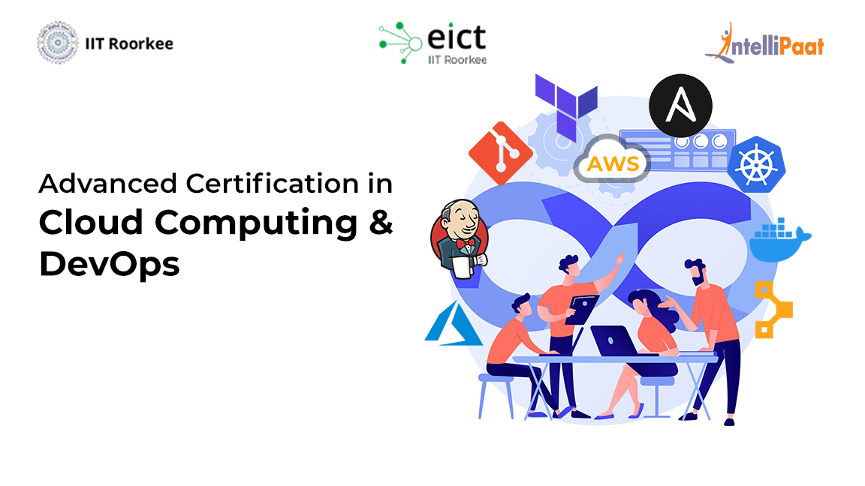
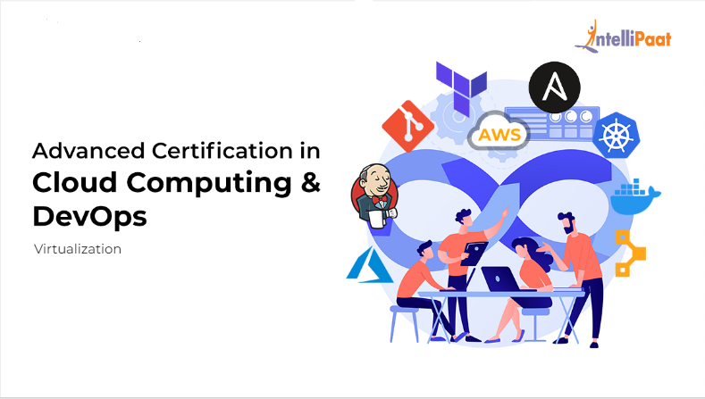
Virtualization

Slide 2
Agenda
01
Virtualization
02
Virtual Machine
03
Hardware virtualization
04
Hypervisor
05
06
Containerization and Docker
Open Flow
07
Docker Components
08
Foundation Engine

Slide 3
Virtualization

Slide 4
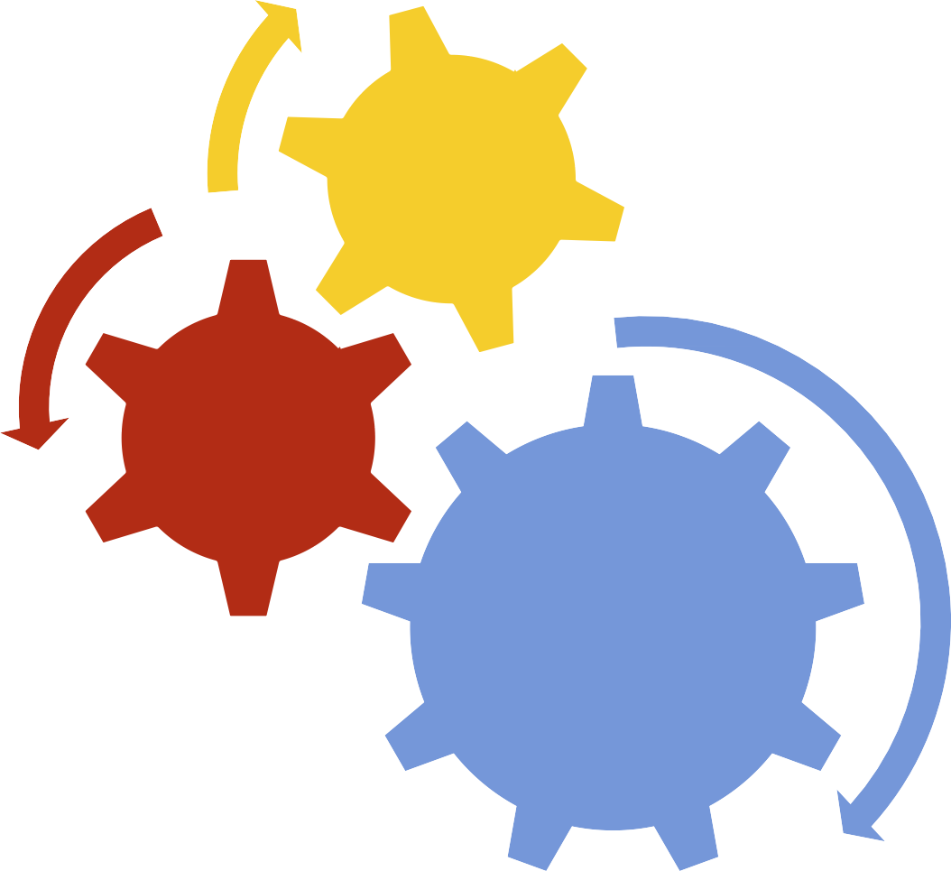
COMPUTER ORGANISATION
I/O Devices
Memory
CPU

Slide 5
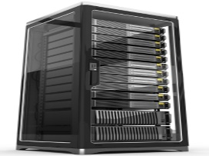
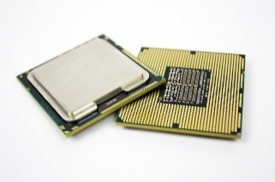
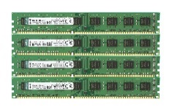
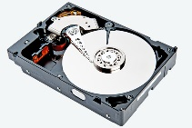
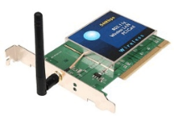
Non Virtualized System
Blackboard
Application
NESS
Application
Student Admissions
Other Application
Server Cluster 1
Server Cluster 2
Server Cluster 3
Server Cluster 4
Consists of
Processor
Memory
Disk
Network
Hardware Failure
v

Slide 6
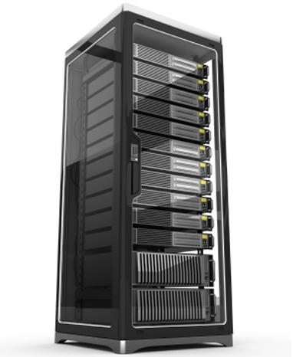
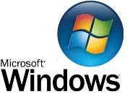

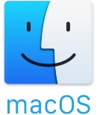
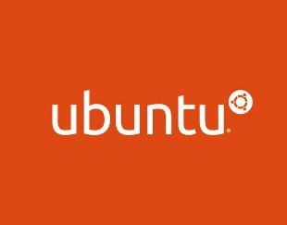
Non Virtualized System
Blackboard
Application
NESS
Application
Student Admissions
Other Application
Server Cluster 1
Server Cluster 2
Server Cluster 3
Server Cluster 4

Slide 7
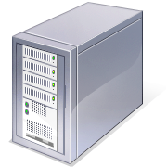
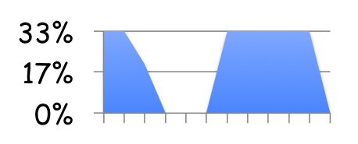
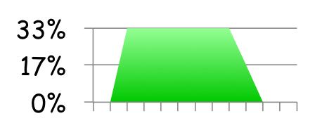
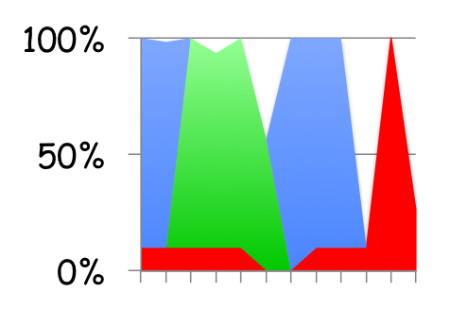
What do we want to achieve with cloud?
Today: static partitioning
Dynamic sharing in clouds
Hadoop
Pregel
Shared IaaS
MPI

Slide 8
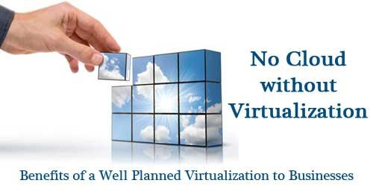
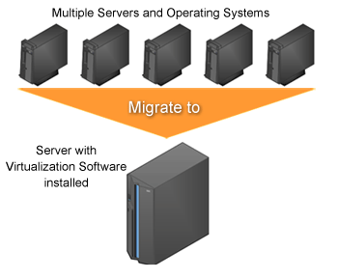
Benefits of Virtualisation
Heterogeneous system consolidation
System testing and workload isolation
Hardware optimization
Application high availability
Elasticity

Slide 9
Virtualization (Overview)
Fundamental component of cloud computing, especially in IaaS.
Allows the creation of secure, customizable, and isolated execution environment, even if untrusted, NOT affecting other users’ applications.
Basic idea: ability of a computer program (software and hardware) to emulate an executing environment separate from the one that hosts such programs.
For example, Windows OS can run on top of a virtual machine, which itself is running on Linux OS.
A great opportunity to build elastically scalable systems
Provision capability with minimum costs.
Virtualization used to deliver customizable computing environments on demand.

Slide 10
Virtualization (Overview)
Large umbrella of technologies & concepts to provide abstract environment (virtual hardware: processing elements (PEs), storage, memory, and networking or an operating system).
Synonymous with hardware virtualization to deliver IaaS.
Operating system level, programming language level and application level.
Interested phenomena:
Increased performance and computing capacity.
Underutilized hardware and software resources.
Lack of space.
Greening initiatives.
Administrative costs.

Slide 11
Virtualization Reference Model
Virtual version of hardware, a software environment, storage, or a network.
Three major components: Guest, Host and, Virtualization layer.
The Guest represents the system component that interacts with the virtualization layer.
Host represents original environment, the guest is supposed to be managed.
Virtualization layer recreates the environment where the guest will operate.
Most intuitive application is represented by hardware virtualization, the guest is represented by a system image comprising an operating system and installed applications.

Slide 12

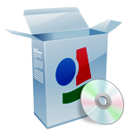
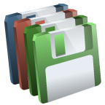
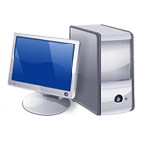


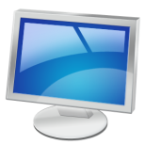

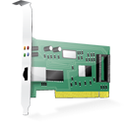
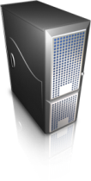

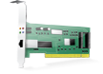

Virtualization Reference Model
Guest
Virtual Image
Applications
Applications
Virtualization Layer
Virtual Hardware
Virtual Storage
Virtual Networking
Software Emulation
Host
Physical Hardware
Physical Storage
Physical Networking

Slide 13
Virtualization Reference Model
Guests are installed on top of virtual hardware, controlled and managed by the virtualization layer (virtual machine manager ((VMM)).
Host is instead represented by the physical hardware, and in some cases the operating system that defines the environment where the VMM is running.
Virtual storage: guest might be client applications interact with the virtual storage management software deployed on top of the real storage system.
Virtual networking: guest interacts with a virtual network (VPN) managed by specific software (VPN client) using the physical network on the node.
VPNs are useful for creating the illusion of being within a different physical network and thus accessing the resources in it, which would otherwise not be available.

Slide 14
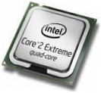
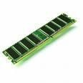
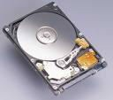
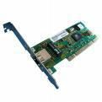
Virtualisation in Conventional Software Infrastructure
Physical Resource | Virtual Resource
CPU | Process
Memory | Virtual Memory
Disk | Files
Network Card | TCP/UDP Sockets
Screen | Windows
Applications
Operating System
Hardware

Slide 15
What do we want to achieve with Virtualization in clouds ?
For one thing, replace several machines with (a bigger) one without changing any software.
IBM did that with VM/370 in 1972

Slide 16
WHY DO THAT?
Save the cost (space, energy, personnel) of running several machines in place of one—a green aspect, too!
Use the (otherwise wasted) CPU power
Clone servers (for example, for debugging) at low cost
Migrate a machine (for example, when the load increases) at low cost
Isolate an appliance—a server for a specific purpose (such as security)—without buying new hardware

Slide 17
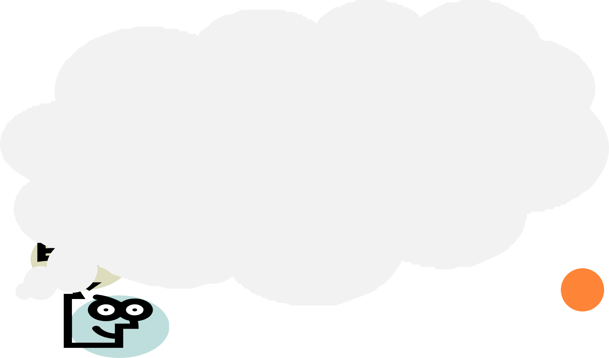
VIRTUALIZATION IN MODERN OPERATING SYSTEM
Each virtualized cloud application thinks that it has
Huge contiguous memory, starting from address 0
CPU power to itself
All I/O devices
 | Memory
0
1
2
3
4
…

Slide 18
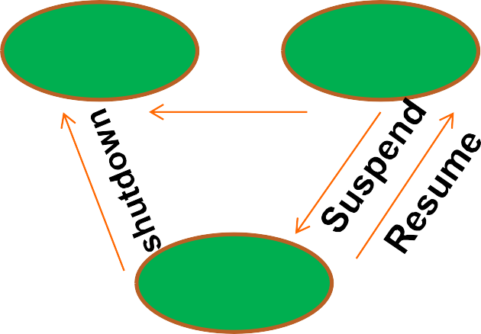
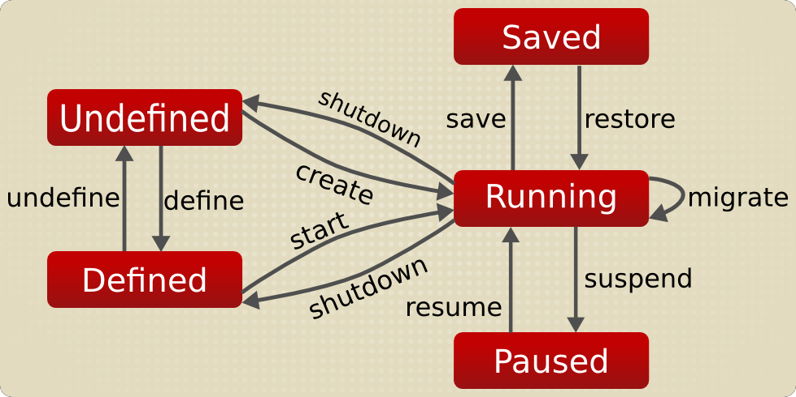
CASE STUDY: LIFECYCLE
Virtual Machine (VM)
after http://wiki.libvirt.org/page/VM_lifecycle# Virtual_Machine_Lifecycle
start
Off
On
shutdown
Paused
Physical Machine

Slide 19
Virtualization: a Technique for Multiple Applications/OS
Applications
Application
Application
VM
Application
Applications
Application
Operating
System
Virtualisation
Operating
System
Operating
System
Operating
System
Operating
System
Operating
System
Hardware
Hardware

Slide 20
Virtualized Infrastructure in Clouds
Virtual Machine (VM)
NOW: Physical Machine (CPU+Mem+Disk+Net+…)
Virtual Cloud Machine (VCPU+Vmem+Vdisk+Vnet+…)
Applications
Applications
Applications
Applications
OS
OS
OS
OS
Virtualisation Layer
Hardware

Slide 21
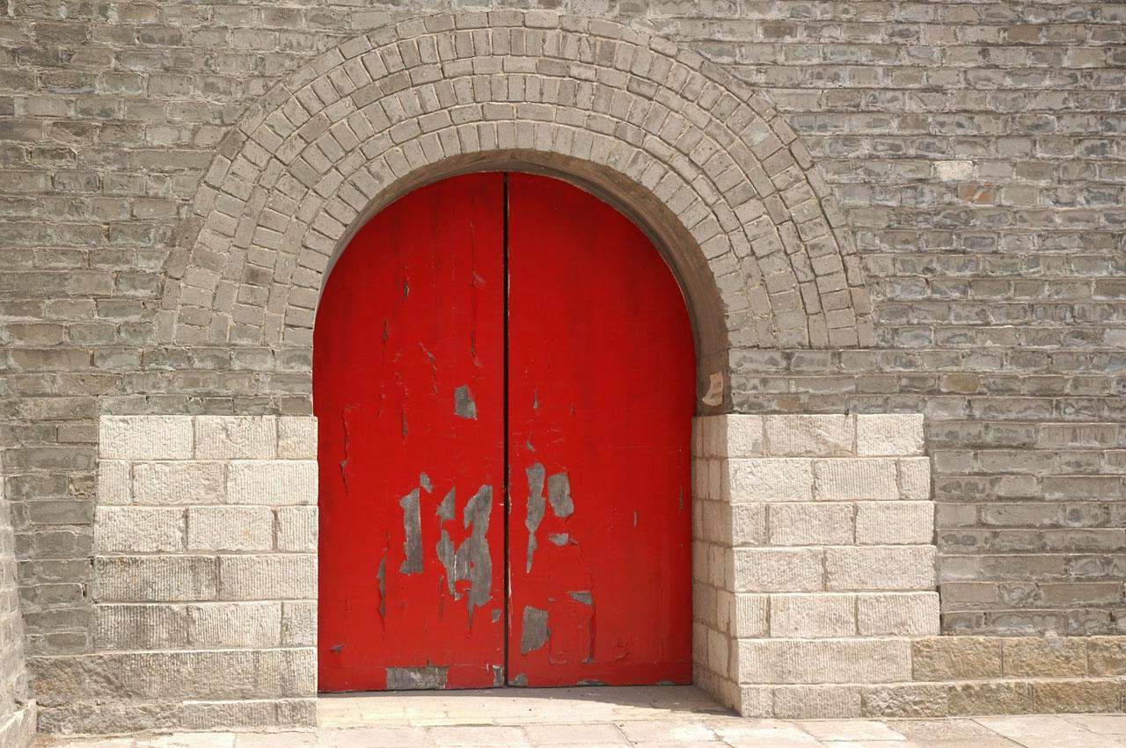
Virtualized Infrastructure in Clouds
The only way to enter the physical hardware is via a software (Operating System) or hardware exception (interrupt or trap!)

Slide 22
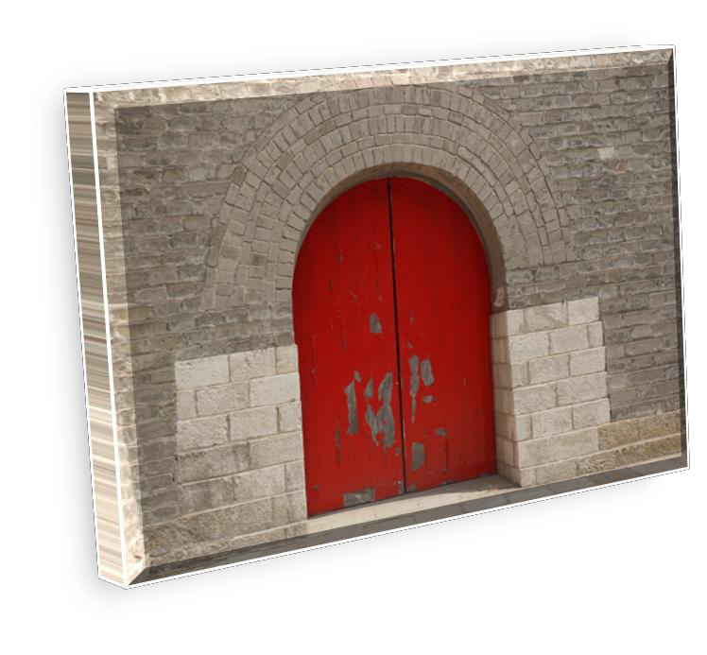

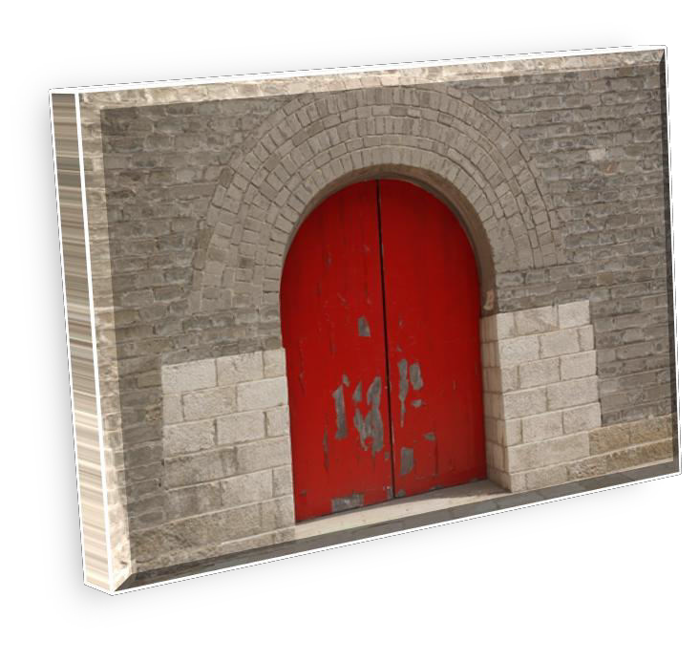
Virtualized Infrastructure in Clouds
VM (interrupts and
traps) enter here
VM (interrupts and
traps) enter here
VM (interrupts and
traps) enter here
Virtualisation Interface: All
visitors (interrupts and traps) enter here
Introduction to Cloud Computing Igor Faynberg 26

Slide 23
Virtualized Infrastructure in Clouds
Server Virtualization – The division of a physical system's resources (e.g. processors, memory, I/O, and storage), where each such set of resources operates independently with its own System Image instance and applications
Virtual Machines
Proxies for physical resources and have the same external interfaces and functions
Composed from physical resources
Virtualization Layer
Creates virtual resources and "maps" them to physical resources
Provides isolation between Virtual Resources
Accomplished through a combination of software, firmware, and hardware mechanisms
Physical Hardware Resources
Hardware components with architected interfaces / functions
Examples: Memory, disk drives, networks, servers

Slide 24
Characteristics of virtualized environments
Increased security :
For guest, a completely transparent and controlled execution environment.
An emulated environment in which the guest is executed.
Guest operations performed on VM, It translates and applies them to the host.
VMM controls and filters the guest activity, thus preventing some harmful operations from being performed, Host is hidden or protected from the guest.
Sensitive information naturally hidden without installing complex security policies.
Increased security is a requirement when dealing with untrusted code. For example, applets downloaded from the Internet run in a sandboxed version o f the Java Virtual Machine(JVM), which provides them with limited access to the hosting operating system resources.

Slide 25
Characteristics of virtualized environments
Increased security :
Hardware virtualization solutions (VMware Desktop, Virtual Box, and Parallels) create a virtual computer with customized virtual hardware on top of which a new operating system can be installed.
By default, the file system exposed by the virtual computer is completely separated from the one of the host machine.

Slide 26
Characteristics of virtualized environments
Managed execution :
Sharing: sharing in virtualized data centers, to reduce the number of active servers and limit power consumption
Aggregation: A group of separate hosts tied together and represented to guests as a single virtual host, implemented in middleware for distributed computing.
Emulation: Controlling and tuning the environment that is exposed to guests.xample: arcade-game emulator to play arcade games on a normal personal
Isolation: Allows multiple guests to run on the same host without interfering with each other, Also, Separation between the host and the guest.

Slide 27
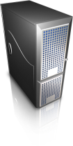
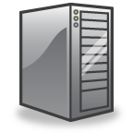
Characteristics of virtualized environments
Virtual Resources
Sharing
Aggregation
Emulation
Isolation
Virtualization
Physical Resources

Slide 28
Characteristics of virtualized environments
Portability:
Hardware virtualization solution: guest packaged into a virtual image that can be safely moved and executed on top of different virtual machines.
Programming-level virtualization: Implemented by JVM or .NET runtime, binary code can be run without any recompilation.
This makes flexible and very straight forward: One version is able to run on different platforms with no changes.
Allows your own system always with you and ready to use as long as the required virtual machine manager is available (services you need available to you anywhere you go).

Slide 29
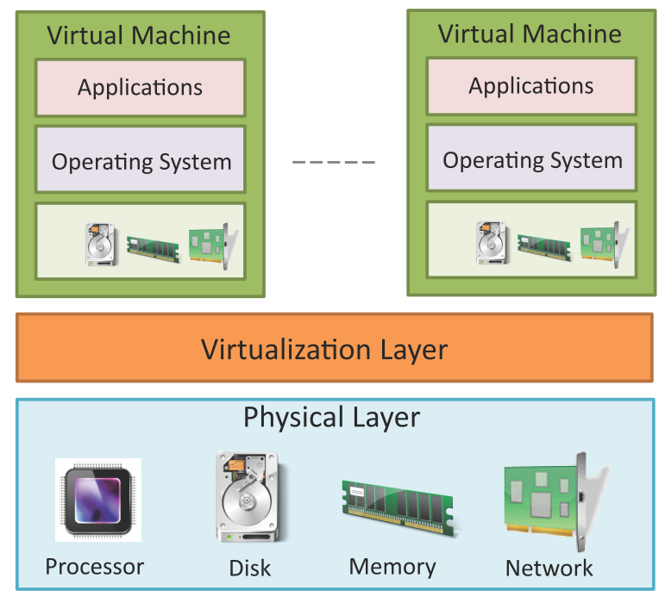
Virtualization in Clouds
Virtualization refers to the partitioning the resources of a physical computing hardware (such as computing, storage, network and memory) into multiple virtual resources or virtual machines (VMs).
Key enabling technology of cloud computing that allow pooling of resources.
In cloud computing, resources are pooled to serve multiple users using multi-tenancy.
There are two major types of Virtualization approaches of cloud hardware at physical layer
Server Virtualization
Network Functions Virtualization
Server Virtualisation
Network Functions Virtualisation

Slide 30
Virtual Machine (VM)
VM can be implemented by adding a software layer to a real machine to support desired architecture, can be applied to entire machine, lie at architected interfaces.
Architecture: a formal specification to an interface in the system, including the logical behavior of the resources managed via the interface.
Implementation describes the actual embodiment of an architecture.
Abstraction levels correspond to implementation layers, having its own interface or architecture.
Guest – system component interacts with Virtualization Layer.
Host – original environment where guest runs.
Virtualization Layer – recreate the same or different environment where guest will run.

Slide 31
Virtualization
How it is done?
Technique
Virtualization Model
Emulation
Application
Execution Environment
Process Level
High-Level VM
Programming Language
Storage
Virtualization
Multiprogramming
Operating System
Network
Hardware-assisted
Virtualization
Full Virtualization
System Level
Hardware
….
Para virtualization
Partial Virtualization

Slide 32
Execution Virtualization
It emulates an Execution Environment (EE), separated from host, implemented on top of H/W by OS, application (libraries) dynamically or statically.
Machine reference model
Virtualizing an execution environment at different levels of computing stack requires a reference model that defines interfaces between levels of abstractions.
Virtualization techniques actually replace one of the layers.
A clear separation between layers simplifies their implementation.
It requires the emulation of interfaces and interaction with underlying layer.

Slide 33
Computing Stack
Applications
Application - level Virtualization
Programming Languages
Programming Language level Virtualization
Execution Stack
Operative Systems
OS- level Virtualization
Hardware
Hardware - level Virtualization

Slide 34
Execution virtualization: Interfaces
Virtualization: extend or replace an existing interface to mimic the behavior of another system.
Instruction Set Architecture (ISA) : processor, registers, memory and the interrupt management or H/W.
Application Binary Interface (ABI): separates OS layer from application and libraries which are managed by the OS, System Calls defined, allows portability of applications and libraries across OS.
Application Programming Interfaces (API): interfaces applications to libraries and/or the underlying OS.
ISA has been divided into two security classes: Privileged Instructions and Non-privileged Instructions.

Slide 35
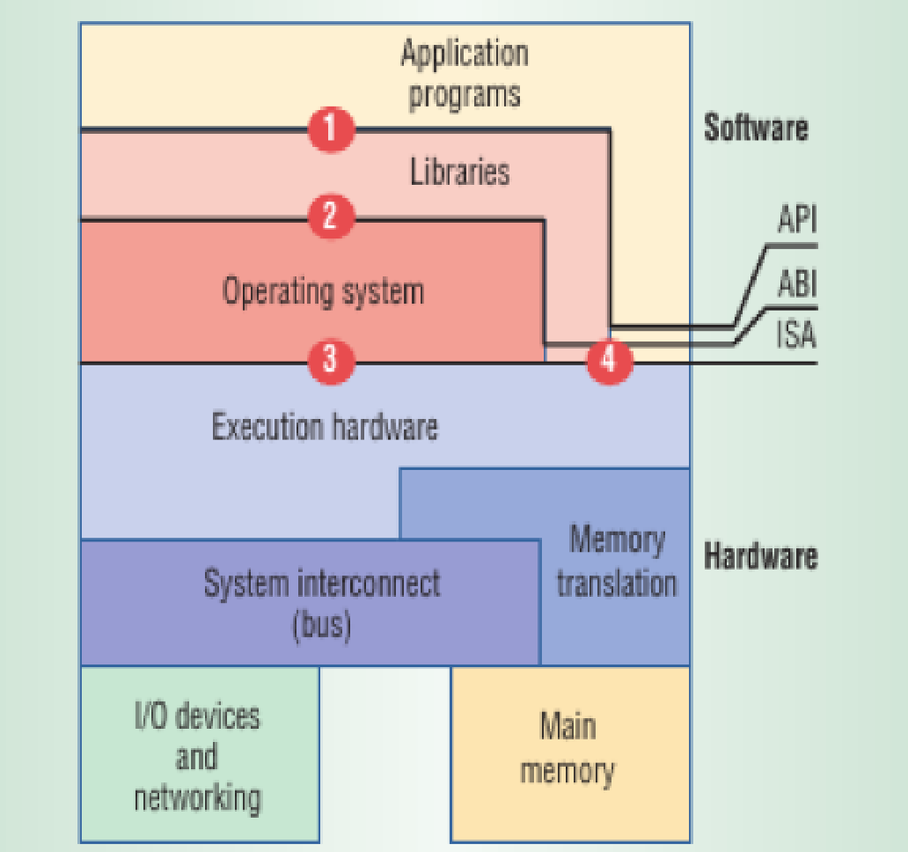
Machine Reference Model
Applications
Applications
API calls
API
Libraries
Libraries
ABI
System calls
User
ISA
User
ISA
Operative System
Operative System
ISA
ISA
Hardware
Hardware
Depending on what is replaced /mimicked, we obtain different techniques of virtualization.

Slide 36
Execution virtualization
Non-privileged instructions can be used without interfering with other tasks because they do not access shared resources (floating, fixed-point, and arithmetic instructions).
Privileged instructions are executed under specific restrictions and mostly used for sensitive operations: behavior-sensitive: operate on the I/O) or control-sensitive: alter the state of the CPU.
Some architectures feature more than one class of privileged instructions
For instance, a hierarchy of privileges see (Fig. Next Slide), in the form of ring-based security: Ring 0, Ring 1, Ring 2, and Ring 3.

Slide 37
Security Rings and Privilege Modes
Least privileged mode
(user mode)
Ring 3
Privileged modes
Ring 2
Ring 1
Ring 0
Most privileged mode
(supervisor mode)
Ring 0 is in the most privileged level and Ring 3 in the least privileged level. Ring 0 is used by the kernel of the OS, rings 1 and 2 are used by the OS-level services, and Ring 3 is used by the user.

Slide 38




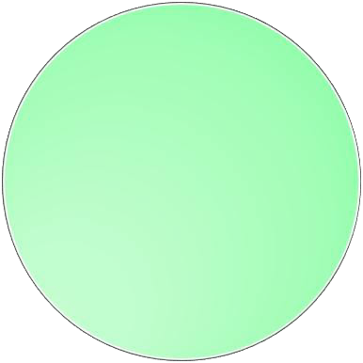

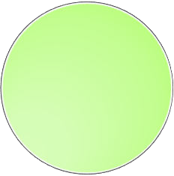





Security Rings and Privilege Modes
Segment Table revisited
… … … …
Start address size ring Access type = {read, write, execute}
(rr
0
1
2
3
4
…
n
… … … …
Code permitted to access ring i may access ring j if and only if j > i,

Slide 39
Execution virtualization
Distinction between user & supervisor mode signifies role of the hypervisor.
Hypervisors run in supervisor mode, and division between privileged and non-privileged instructions makes challenging design of virtual machine managers.
Sensitive instructions execute in privileged mode, requires supervisor mode to avoid traps.
Without this assumption it is impossible to fully emulate and manage the status of the CPU for guest operating systems.
This is not true for the original ISA, allows 17 sensitive instructions to be called in user mode, prevents multiple OSs managed by a single hypervisor to be isolated from each other.
Since, they access the privileged state of the processor and change it.

Slide 40
Execution virtualization
Recent implementations of ISA (Intel VT and AMD Pacifica) solved this problem by redesigning such instructions as privileged ones.
In hypervisor-managed environment, all guest OS code will run in user mode in order to prevent it from directly accessing the status of the CPU.
If there are sensitive instructions that can be called in user mode, it is no longer possible to completely isolate the guest OS.

Slide 41
Hardware Virtualization
It provides an abstract execution environment in terms of computer hardware on top of which a guest operating system can be run.
The guest is represented by the operating system, the host by the physical computer hardware, the virtual machine by its emulation, and the virtual machine manager by the hypervisor (see Figure).
The hypervisor is generally a program or a combination of software and hardware that allows the abstraction of the underlying physical hardware.
Hardware-level virtualization is also called System level Virtualization.
Since, it provides ISA to virtual machines, which is the representation of the hardware interface of a system.
This is to differentiate it from process virtual machines, which expose ABI to virtual machines.

Slide 42

A hardware virtualization reference model
Guest
In memory
representation
Storage
Virtual Image
VMM
Host emulation
Virtual Machine
binary translation
instruction mapping
interpretation
……
Host

Slide 43
Hardware Virtualization
Hypervisors(or VMM):
Hypervisor runs above the physical hardware.
It runs in supervisor mode.
It recreates a h/w environment in which guest operating systems are installed.
It is a piece of s/w that enables us to run one or more VMs on a physical server(host).
Two major types of hypervisor
– Type -I
– Type-II

Slide 44
Hardware Virtualization
Hypervisors (Type-I):
It runs directly on top of the hardware, takes place of OS.
Directly interact with the ISA exposed by the underlying hardware, and emulate this interface in order to allow the management of guest OS.
Also known as native virtual machine.
Hypervisors (Type-2):
It requires the support of an operating system to provide virtualization services.
Programs managed by the OS, interact with OS through the ABI.
Emulate the ISA of virtual h/w for guest OS.
Also called hosted virtual machine.
No modification to Operating System code for both Type-1 and Type-2 hypervisors

Slide 45
Hosted and Native Hypervisors
VM
VM
VM
VM
ISA
Virtual Machine Manager
VM
VM
VM
VM
ABI
ISA
Operative System
Virtual Machine Manager
ISA
ISA
Hardware
Hardware

Slide 46
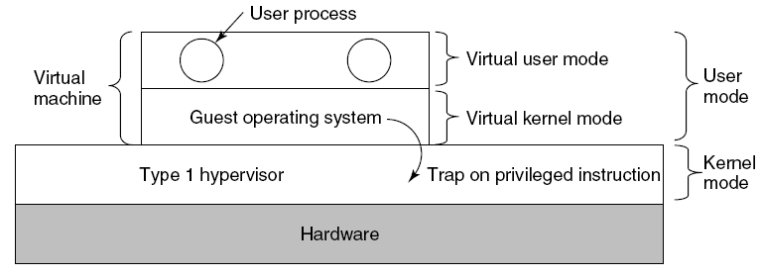
Type 1 Hypervisor
Unmodified Operating System is running in user mode
But it thinks it is running in kernel mode (virtual kernel mode)
privileged instructions trap;
Hypervisor is the “real kernel”
Upon trap, executes privileged operations
Or emulates what the hardware would do
Ex: VMware ESXi or Microsoft Hyper-V

Slide 47
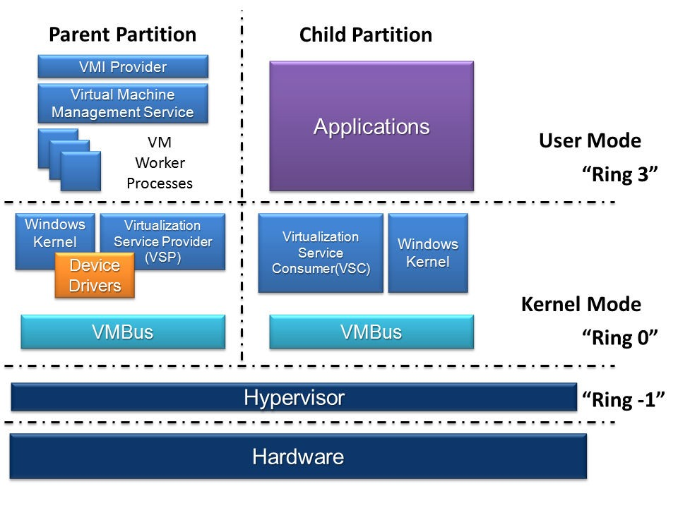
Type 1 Hypervisor CASE STUDY MICROSOFT HYPER-V

Slide 48
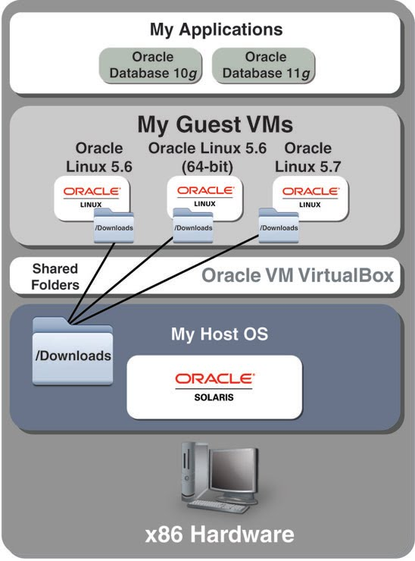
Type 2 Hypervisor
VMWare example
Type 2 hypervisor Upon loading program: scans code for basic blocks
If sensitive instructions, replace by VMware procedure
Binary translation
Cache modified basic block in VMWare cache
Execute; load next basic block etc.
Type 2 hypervisors work without VT (no automatic trapping of privileged instructions by hypervisors) support.

Slide 49
Hardware Virtualization
VMM: Main Modules coordinate to emulate the underlying hardware:-
Dispatcher: Entry Point of VMM
Reroutes the instructions issued by VM instance.
Allocator: Decides system resources to be provided to the VM;
a VM executes an instruction, results in changing machine resources associated with that VM.
Invoked by dispatcher
Interpreter: Consists of interpreter routines
Executed whenever a VM executes a privileged instruction.
Trap is triggered and the corresponding routine is executed.

Slide 50



VMM
Virtual Machine Instance
ISA
Instructions (ISA)
Virtual Machine Manager
Dispatcher
Interpreter
Routines
Interpreter
Routines
Allocator

Slide 51
Hardware Virtualization
Criteria of VMM*:
Equivalence – same behavior as when it is executed directly on the physical host when it was running under control of VMM.
Resource control – VMM should be in complete control of virtualized resources.
Efficiency – a statistically dominant fraction of the machine instructions should be executed without intervention from the VMM.
Theorems*: Classification of the instruction set and proposed three theorems that define the properties that hardware instructions need to satisfy in order to efficiently support virtualization.
Classification of IS:
Privileged Instructions: trap if the processor is in user mode
Control sensitive Instructions
Behavior sensitive Instructions
* criteria’s are established by Goldberg and Popek in 1974

Slide 52
Hardware Virtualization
Theorem 1*:
For any conventional third-generation computer, a VMM may be constructed if the set of sensitive instructions for that computer is a subset of the set of privileged instructions.
Privileged Instructions
Sensitive Instructions
User Instructions

Slide 53
Hardware Virtualization
Theorem 2 *:
A conventional third-generation computers is recursively virtualizable if:
It is virtualizable and
A VMM without any timing dependencies can be constructed for it.
Theorem 3 *:
A hybrid VMM may be constructed third-generation machine in which the set of user-sensitive instructions is a subset of the set of privileged instructions.
In HVM, more instructions are interpreted rather than being executed directly.

Slide 54
Hardware Virtualization
Hardware virtualization Techniques:
CPU installed on the host is only one set, but each VM that runs on the host requires their own CPU.
CPU needs to be virtualized, done by hypervisor.
Types of HVT:
Full virtualization
Hardware-assisted virtualization
Para virtualization
Partial virtualization

Slide 55
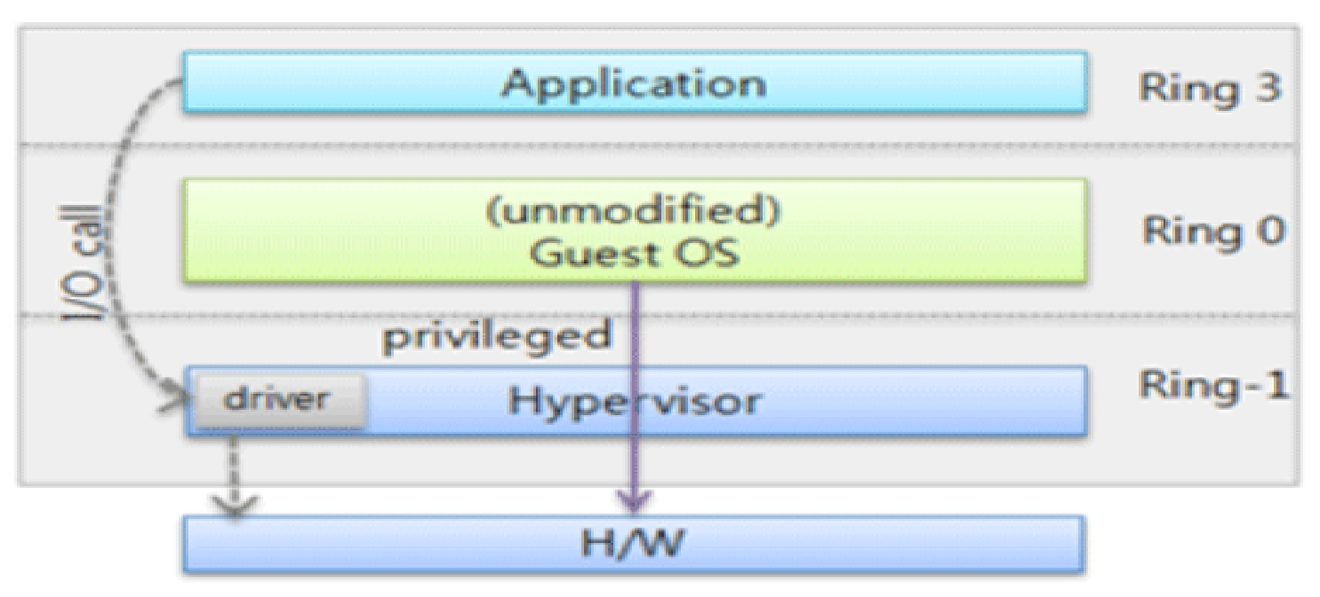
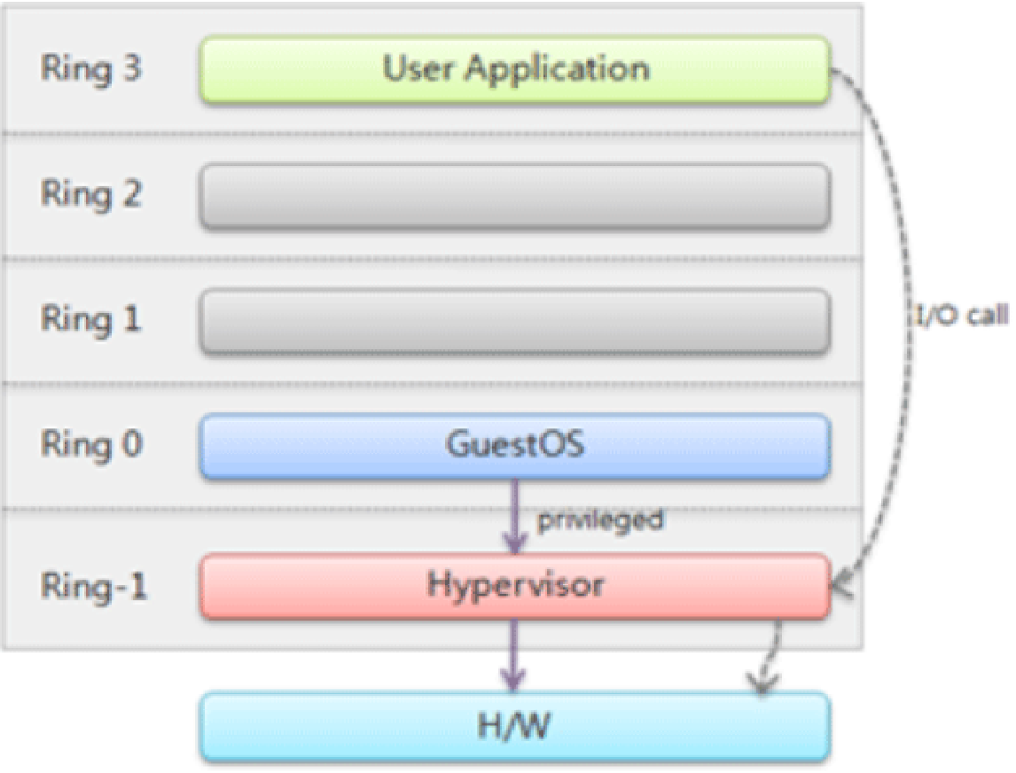
Hardware Virtualization
Hardware-assisted virtualization:
In this hardware provides architectural support for building a VMM able to run a guest OS in complete isolation.
Intel VT and AMD V extensions.
Early products were using binary translation to trap some sensitive instructions and provide an emulated version.
Additional Ring -1
No binary translation of privileged instructions.
Commands are executed directly to h/w via the hypervisor.

Slide 56
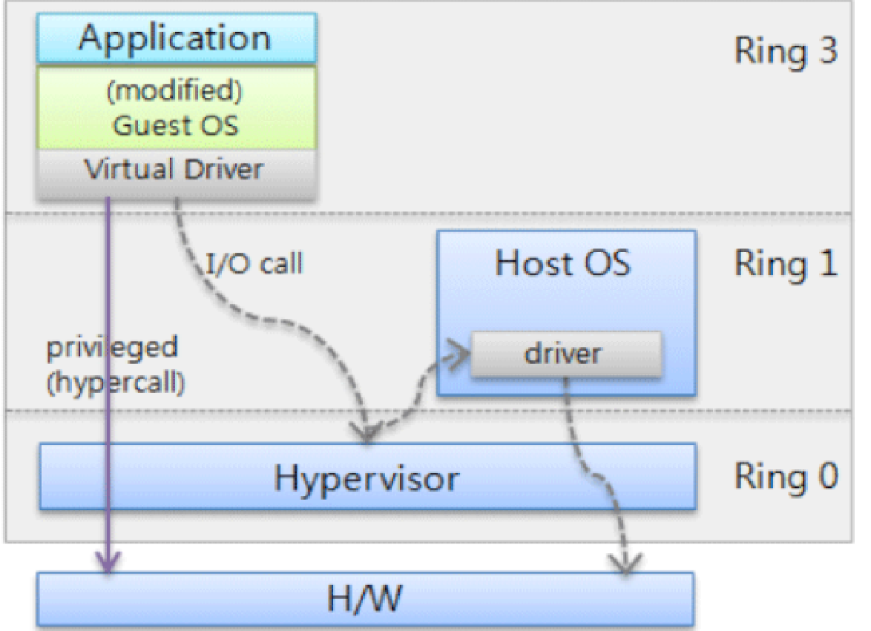
Hardware Virtualization
Para virtualization:
Not-transparent virtualization
– Thin VMM
– Expose software interface to the virtual machine that is slightly modified from the host.
– Guest OS needs to be modified.
– Simply transfer the execution of instructions which were hard to virtualized, directly to the host.
Privileged instructions of guest OS is delivered to the hypervisor by using hyper calls
Hyper calls handles these instructions and accesses the h/w and return the result.
Guest has authority to directly control of resources.

Slide 57
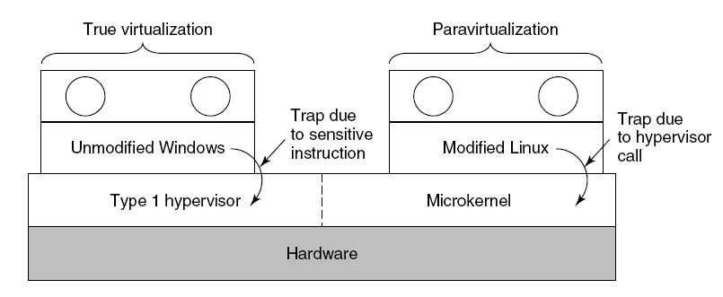
Para virtualisation
Ring 3
Application
Both type 1 and 2 hypervisors work on unmodified OS
Para virtualisation: modify OS kernel to replace all sensitive instructions with hyper calls
OS behaves like a user program making system calls
Hypervisor executes the privileged operation invoked by hyper call.
Direct
Execution
of user and OS
Requests
Ring 2
Ring 1
Ring 0
Paravirtualized
Guest OS
Virtualization layer
Hyper calls to the
Virtualization Layer
replace
non-virtualiable
OS instructions
Hardware

Slide 58
Hardware Virtualization
Partial virtualization:
Partial emulation of the underlying hardware
Not allow complete isolation to guest OS.
Address space virtualization is a common feature of
Contemporary operating systems.
Address space virtualization used in time-sharing system.

Slide 59
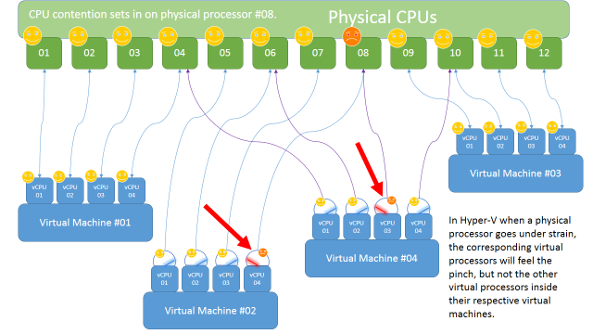
Virtual CPU (VM) scheduling
Based on fair-share balancing algorithm
Each VM gets equal time on the processor
The VMs are allocated to physical processor core based on (Availability, Utilization, Priority (Research!!!))
How privileged instructions requested by VMs depends on
Type of virtualization ( Full virtualization, Para Virtualization, …)

Slide 60
Operating System-level virtualization
To create different and separated execution environments for applications that are managed concurrently.
No VMM or hypervisor.
Virtualization is in single OS.
OS kernel allows for multiple isolated user space instances.
OS kernel is responsible for sharing the system resources among instances and other management.
A user space instance has a proper view of the file system (isolated), separate IP addresses, software configurations, and access to devices.
OS supporting virtualization are general-purpose, time-shared operating systems with the capability to provide resource isolation.

Slide 61
Operating System-level virtualization
Considered an evolution of the Chroot mechanism in Unix systems.
Compared to H/W virtualization, no overhead because applications directly use OS system calls and there is no need for emulation.
No need to modify applications, nor to modify any specific hardware.
Good for server consolidation; multiple application servers share the same technology: operating system, application server framework etc.
Different servers are aggregated into one physical server, each server is run in a different user space, completely isolated from the others. Ex: OpenVZ, IBM Logical Partition (LPAR), Solaris Zones and Containers.

Slide 62
Programming language-level virtualization
To ease deployment of applications, managed execution, Security and portability across different platforms (OSs).
A virtual machine executes the byte code of a program.
VMs constitute a simplification of the underlying hardware instruction set and provide some high-level instructions that map some of the features of the languages compiled for them.
At runtime, byte code can be either interpreted or compiled on the fly (JIT) against underlying hardware instruction set.
Both Java and the Common Language Infrastructure (CLI), are stack-based virtual machines.
Stack-based virtual machines possess the property of being easily interpreted and executed simply by lexical analysis and hence are easily portable over different architectures.

Slide 63
Application-level virtualization
Applications run in runtime environments that do not natively support all the features required by such applications.
Applications are not installed in the expected runtime environment but are run as though they were.
Mostly concerned with partial file systems, libraries, and operating system component emulation.
Such emulation is performed by a thin layer—a program or an operating system component—that is in charge of executing the application.
Emulation can also be used to execute program binaries compiled for different hardware architectures.

Slide 64
Application-level virtualization
Emulation strategies implemented:
Interpretation: source instruction is interpreted by an emulator for executing native ISA instructions, minimal start up cost but huge overhead.
Binary translation: source instruction is converted to native instructions with equivalent functions.
Block of instructions translated , cached and reused.
Large overhead cost , but over time it is subject to better performance.
In h/w virtualization , it allows the execution of a program compiled against a different h/w.
In Application level emulation , complete h/w environment.

Slide 65
Other types of virtualization
Desktop virtualization : abstracts the desktop environment available on a personal computer to access it using a client/server approach.
Same outcome of hardware virtualization but serves a different purpose, makes accessible a different system as though it were natively installed on the host, but this system is remotely stored on a different host and accessed through a network connection.
Same desktop environment accessible from everywhere.
A highly available data center ensures the accessibility and persistence of the data, that is required.

Slide 66


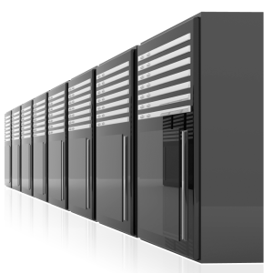







What is a Virtual Desktop?
Virtual Desktop Infrastructure (VDI) and Remote Desktop Services session-based desktops are the key technologies that enable virtual desktops, whereby a desktop that runs in the data center can be delivered to the end-user’s device using Remote Desktop Protocol (RDP). When combined with technologies that enable application and user state virtualization, organizations can achieve a high degree of desktop optimization and security and reduced TCO.
Operating System
VDI and session-based desktops are just another deployment model for Windows

Slide 67
Other types of virtualization
Storage virtualization: A system administration practices decoupling the physical organization of the hardware from its logical representation.
No worried about the specific location of their data, it can be identified using a logical path.
Harness a wide range of storage facilities and represent them under a single logical file system.
Storage Area Network (SANs) use a network-accessible device through a large bandwidth connection to provide storage facilities.

Slide 68
Other types of virtualization
Network Virtualization: combines hardware appliances and specific software for the creation and management of a virtual network.
Aggregate different physical networks into a single logical network (external network virtualization).
Provide network-like functionality to an operating system partition (internal network virtualization)
The result of external network virtualization is generally a virtual LAN.
A VLAN is an aggregation of hosts that communicate with each other as though they were located under the same broadcasting domain.
Internal network virtualization is applied together with hardware and operating system-level virtualization, in which the guests obtain a virtual network interface to communicate with.

Slide 69
Data Centre Network Function Virtualization
Network Function Virtualization (NFV) is a technology that leverages virtualization to consolidate the heterogeneous network devices onto industry standard high volume servers, switches and storage.
Relationship to SDN (Software Defined Networking)
NFV is complementary to SDN as NFV can provide the infrastructure on which SDN can run.
NFV and SDN are mutually beneficial to each other but not dependent.
Network functions can be virtualized without SDN, similarly, SDN can run without NFV.
NFV comprises of network functions implemented in software that run on virtualized resources in the cloud.
NFV enables a separation the network functions which are implemented in software from the underlying hardware.

Slide 70

Cloud Data Centre Network

Slide 71

NFV Architecture
Key elements of the NFV architecture are
Virtualized Network Function (VNF): VNF is a software implementation of a network function which is capable of running over the NFV Infrastructure (NFVI).
NFV is a network architecture concept that uses the technologies of IT virtualization to virtualize entire classes of network node functions into building blocks that may connect, or chain together, to create communication services.

Slide 72

Software Defined Networking
Software-Defined Networking (SDN) is a networking architecture that separates the control plane from the data plane and centralizes the network controller.
Conventional network architecture
The control plane and data plane are coupled. Control plane is the part of the network that carries the signaling and routing message traffic while the data plane is the part of the network that carries the payload data traffic.
SDN Architecture
The control and data planes are decoupled and the network controller is centralized.

Slide 73
SDN - Key Elements
Centralized Network Controller
With decoupled the control and data planes and centralized network controller, the network administrators can rapidly configure the network.
Programmable Open APIs
SDN architecture supports programmable open APIs for interface between the SDN application and control layers (Northbound interface). These open APIs that allow implementing various network services such as routing, quality of service (QoS), access control, etc.
Standard Communication Interface (Open Flow)
SDN architecture uses a standard communication interface between the control and infrastructure layers (Southbound interface). Open Flow, which is defined by the Open Networking Foundation (ONF) is the broadly accepted SDN protocol for the Southbound interface.

Slide 74

Open Flow
Open Flow is the broadly accepted SDN protocol for the Southbound interface.
With Open Flow, the forwarding plane of the network devices can be directly accessed and manipulated.
Open Flow uses the concept of flows to identify network traffic based on pre-defined match rules.
Flows can be programmed statically or dynamically by the SDN control software.
Open Flow protocol is implemented on both sides of the interface between the controller and the network devices.
Open Flow switch comprising of one or more flow tables and a group table, which perform packet lookups and forwarding, and Open Flow channel to an external controller.

Slide 75


Local DISK I/O Virtualization
Each guest OS thinks it “owns” the disk
Hypervisor creates “virtual disks”
Large empty files on the physical disk that appear as “disks” to the guest OS
Hypervisor converts block # to file offset for I/O
Direct Memory Access (DMA) needs physical addresses
Hypervisor needs to translate
Guest OS
Guest Device Driver
Device Emulation
Hypervisor I/O Stack
Hypervisor I/O stack
Physical Device Driver
translates guest I/O addresses to host addresses handles inter VM communication
multiplexes I/O requests from/to the physical device
provides enterprise-class I/O features
Physical Device

Slide 76


Local Network Function (I/O) Virtualization
Guest OS
Guest OS
Guest OS
1. DMA packet into receive buffers owned by VM kernel
2. Raise physical Interrupt
3. Parse packet to find destination VM
4. Copy packet into guest receive queue
5. Raise virtual NIC interrupt
5
4
3
Virtualization Layer
2
1
Packets

Slide 77

Virtualization and Cloud Computing (VM Migration)
Server A
(running)
Server B
(running)
VM
VM
VM
VM
VM
VM
Virtual Machine Manager
Before Migration
Server A
(running)
Server B
(inactive)
VM
VM
VM
VM
VM
VM
Virtual Machine Manager
After Migration

Slide 78
Virtualization and Cloud Computing
Degree of customization, security, isolation, and manageability.
Virtual computing environment
Hardware virtualization is Infrastructure-as-a-Service (IaaS).
Programming language virtualization is Platform-as-a-Service (PaaS) offerings.
Attractive business opportunity for companies featuring a large computing infrastructure.
Isolated and controllable environments
Server consolidation: underutilized active resources reduced by aggregating VMs to small number of resources, can be fully utilized.
Movement of virtual machine instances (VM migration).

Slide 79
Containerization and Docker

Slide 80

Movement in the cloud
Migrate workloads to cloud
80%
Portability across environments
Want to avoid cloud vendor lock-in

Slide 81
Application Modernization
Application Code
Developer Issues:
Micro services: Break application into separate operations
Minor code changes require full re-compile and re-test
Application becomes single point of failure
Application is difficult to scale
12-Factor Apps: Make the app independently scalable, stateless, highly available by design

Slide 82

A History Lesson
One application on one physical server

Slide 83

Historical limitations of application deployment
Slow deployment times
Huge costs
Wasted resources
Difficult to scale
Difficult to migrate
Vendor lock in

Slide 84

A History Lesson
Hypervisor-based Virtualization
One physical server can contain multiple applications
Each application runs in a virtual machine (VM)

Slide 85



Benefits of VMs
Better resource pooling
One physical machine divided into multiple virtual machines
Easier to scale
VMs in the cloud
Rapid elasticity
Pay as you go model

Slide 86



Limitations of VMs
Each VM stills requires
CPU allocation
Storage
RAM
An entire guest operating system
The more VMs you run, the more resources you need
Guest OS means wasted resources
Application portability not guaranteed

Slide 87

What is a container?
Standardized packaging for software and dependencies
Isolate apps from each other
Share the same OS kernel
Works with all major Linux and Windows Server

Slide 88


Comparing Containers and VMs
VMs are an infrastructure level construct to turn one machine into many servers
Containers are an app level construct

Slide 89

Containers and VMs together
Containers and VMs together provide a tremendous amount of
flexibility for IT to optimally deploy and manage apps.

Slide 90

What is Docker?
Docker is a platform for developing, shipping & running application using container based virtualization technology.

Slide 91
History of Docker
2013
Solomon Hykes starts Docker as an internal project within dot Cloud
Feb 2016
Docker introduces first commercial product – now called Docker Enterprise Edition
2008
Linux containers
(LXC 1.0)
introduced
Today
Open source community includes
2004
Solaris Containers / Zones technology introduced
Mar 2013
Docker released to open source
3,300+ contributors
- 43,000+ stars
- 12,000+ forks

Slide 92

Incredible adoption in just 4 years

Slide 93
Key Benefits of Docker Containers
Portability
Less dependencies between process layers = ability to move between infrastructure
Efficiency
Less OS overhead
Improved VM
density
Speed
No OS to boot = applications online in seconds

Slide 94
Docker Components: Docker Image
A Docker image is a binary that includes all of the requirements for running a single Docker container, as well as metadata describing its needs and capabilities.

Slide 95
Docker Components: Docker File
A Docker file is a text document that contains all the commands a user could call on the command line to assemble an image. Using Docker build users can create an automated build that executes several command-line instructions in succession.
Docker file is used for automation of work by specifying
all step that we want on docker image

Slide 96
Docker Components: Docker Container
Images are read only containers used to create containers.
Built by you or other Docker Users.
Stored in Docker hub or your local repository

Slide 97
Docker Components: Docker Engine
Docker Engine is the program that enables containers to build shipped & run.
Docker Engine uses Linux Kernel namespace & control group.
Namespace gives us the isolated workspace.

Slide 98
Installing Docker & Running Hello World
Install docker with command
# curl -sSL https://get.docker.com/ | sh
Run the hello world container to test your installation # sudo docker run hello-world

Slide 99

Docker Components :Registry / Repository
Where we store our image is known as registry
You can use your own registry or docker's public registry. Known as Docker Hub

Slide 100
Docker Components: Docker Hub
Docker hub is the public registry that contains large amount of images available for your use.
Official Repositories are available at https://hub.docker.com/explore/

Slide 101
Docker Components: Intro to Images
Go to https://hub.docker.com/ and sign up for an account.
Find your confirmation email and active your account.
Explore images from docker hub.
Understanding official Images, Tags
Search images on docker hub.

Slide 102

Deployment Lifecycle Container Image and instance
Docker Case Study

Slide 103
Benefits of using Docker
Separation of Concerns
Life becomes easier for System admin
Fast deployment cycle
Application portability
Build in one environment, Ship anywhere.
Scalability
Easy sign up new containers if needed.
Run more apps on host machine

Slide 104
Docker Networking
Containers can talk to each other without having to expose ports to host.
Essential for micro service application architecture.
Example:
-Container with Tomcat running
-Container with MySQL running
-Application on tomcat needs to connect to MySQL

Slide 105
Container vs VM
Containers are more lightweight.
No need to install guest OS.
Less CPU, RAM, Storage needed.
More containers per machine than VM.

Slide 106











Containers as a Service
Developers
IT Operations
BUILD
Development Environments
SHIP
Secure Content & Collaboration
RUN
Deploy, Manage, Scale
Control plane
Registry
Multi-container apps
Engines running on servers in cloud or data center
Clients pull and push images
Images stored in repos

Slide 107










Docker is in the Enterprise
Service Provider
Healthcare & Science
Financial Services
Tech
Insurance
Public Sector

Slide 108
OS-level virtualisation (Containerisation)
OS-Level Virtualization
Containers are light-weight alternatives to hypervisor-based VMs
Container is a collection of operating system kernel utilities (bins/runtime libs) configured to manage the physical hardware resources used by a particular micro service (user process or app)
Popular container engine implementation includes Docker, and Open VZ
OS
Container 1
OS
Container 2
OS
Container 3
OS virtualization
Container Engine (e.g., Docker)
Standard
Host OS
Physical Cloud Hardware

Slide 109

Resource sharing (CPU, Disk, I/o) across containers

Slide 110


Difference between VM Image and VM instance
A virtual Machine Image (VMI) is a file (e.g., XML) that describes the software configurations of a virtual machine.
From an VMI, you launch an instance, which is a copy of the VMI running as a virtual server in the cloud. An instance type has hardware configurations.
Table 1: VMI Configurations
Table 2: Numerical Instance Configurations

Slide 111

Difference between Container Image and instance
A Container Image is a file (e.g., JavaScript Object Notation) that describes the software configurations and is a snapshot (e.g., run-time libs, dependencies, OS type) of a container.
From Container Image, you launch Container Instance, which is a copy of the image running as a container in the cloud or on your local machine.
Table 1: Container Image Configurations

Slide 112
VM Image vs. Container Image
Table 1: VMI Configurations
Table 2: Container Image Configurations

Slide 113







One platform and one journey for all applications
1
Traditional apps in containers
Gain portability, efficiency and security
2
Transform to Micro services
Look for shared services to transform
3
Accelerate New Applications
Greenfield innovation

Slide 114

Difference between VM Image and VM instance
A virtual Machine Image (VMI) is a file (e.g., XML) that describes the software configurations of a virtual machine.
From an VMI, you launch an instance, which is a copy of the VMI running as a virtual server in the cloud. An instance type has hardware configurations.
Table 1: VMI Configurations
Table 2: Numerical Instance Configurations
Table 2.1: Non-numerical Instance Configurations

Slide 115
Docker Components: Docker Orchestration
Three tools for orchestrating distributed applications with Docker
Docker Machine
Tool that provides Docker Hosts and install the Docker Engine on them.
Docker Swarm
Tool that clusters many Engines and schedules containers.
Docker Compose
Tool to create and manage multi-container application.

Slide 116
Foundation: Docker Engine
Integrated Security
Security | Network | Volumes
Distributed State | Container Runtime | Orchestration
Docker Engine

Slide 117

Building a Secure Supply Chain
Private Image Registry | Secure Access and User Management | Application and Cluster Management
Image Scanning and Monitoring Security | Content Trust and Verification Network | Policy Management
 |  | Volumes
Distributed State | Container Runtime | Orchestration
Enterprise Edition
Image Scanning and Monitoring
Content Trust and Verification
Security
Network
Docker Engine
Usable Security
Trusted Delivery
Portable

Slide 118










Continuous Integration and Delivery
1. Development 2. Test 3. Stage / Production
Version control
Sysadmin
Developer
QA / QE

Slide 119
Quick Security Consideration
Docker demon needs to run as root.
Ensure that, only trusted can control Docker Demon.
If binding the demon to a TCP socket, secure it with TLS
Use linux hardening solutions
SELinux
GRSEC

Slide 120





Docker delivers agility, security and cost savings
Hardened containers deliver new levels of security to monoliths on the transition to micro services
Transform monoliths to secure and agile DevOps environments
Reduce maintenance costs by 10X for legacy, commercial and new apps

Slide 121
Docker delivers agility, resiliency, portability security and cost savings for all applications
Commercial Off The Shelf Apps
Home grown Traditional Apps
Micro services Apps
13X
More software releases
65%
Reduction in developer on boarding time
~47%
Reduction in VMs, OS licensing and Server costs
Eliminate
“works on my machine”
issues
62%
Report reduction in MTTR
10X
Cost reduction in maintaining existing applications

Slide 122


India: +91-7022374614
US: 1-800-216-8930 (TOLL FREE)
support@intellipaat.com
24/7 Chat with Our Course Advisor
Notes:
Thank you!

